Slide 1
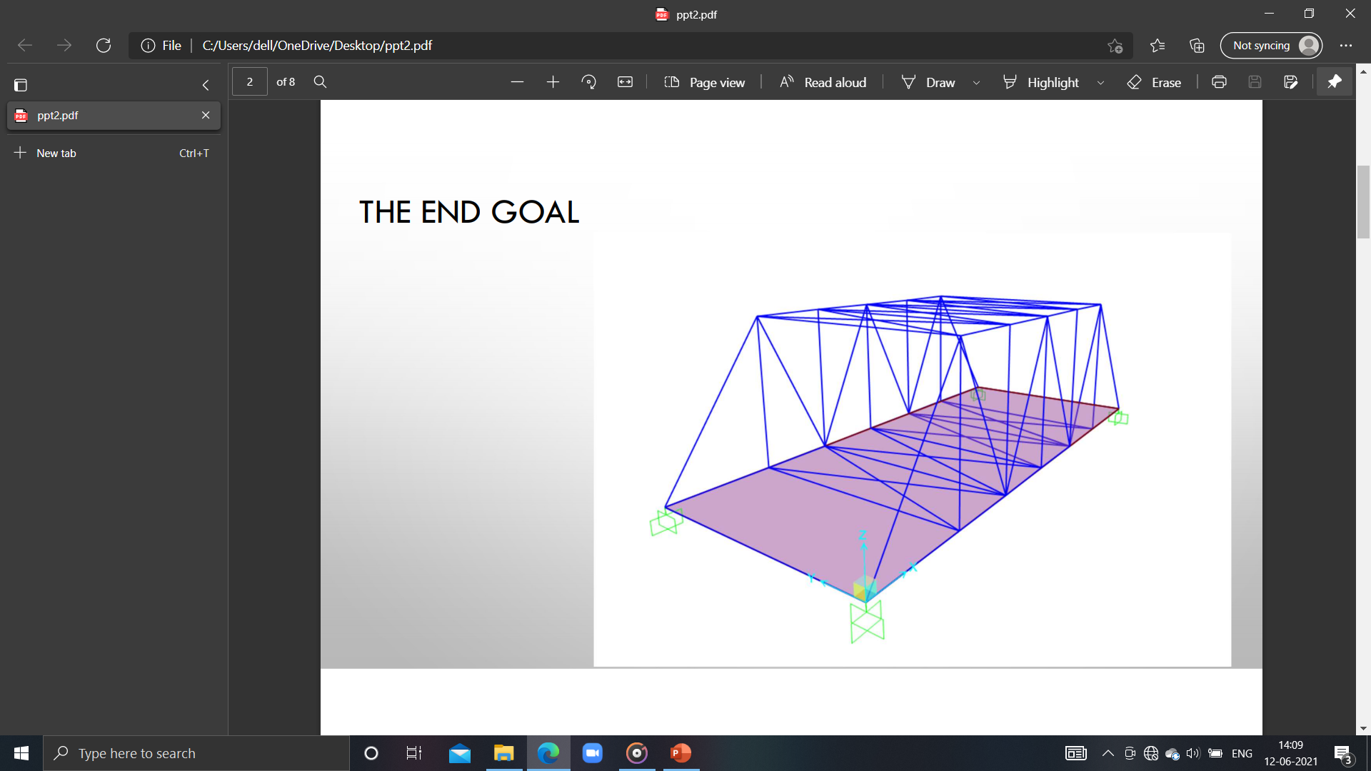
Descon society
ASSIGNMENT 2
PRESENTATION
STRUCTURE SUPER COMBO PART-2

Slide 2
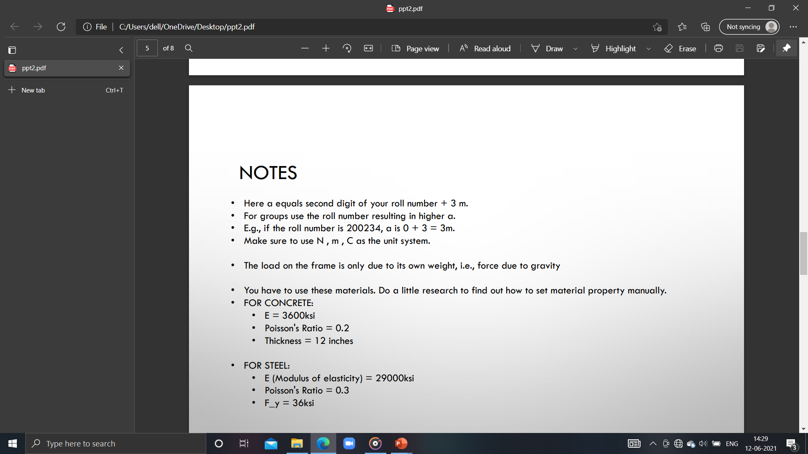
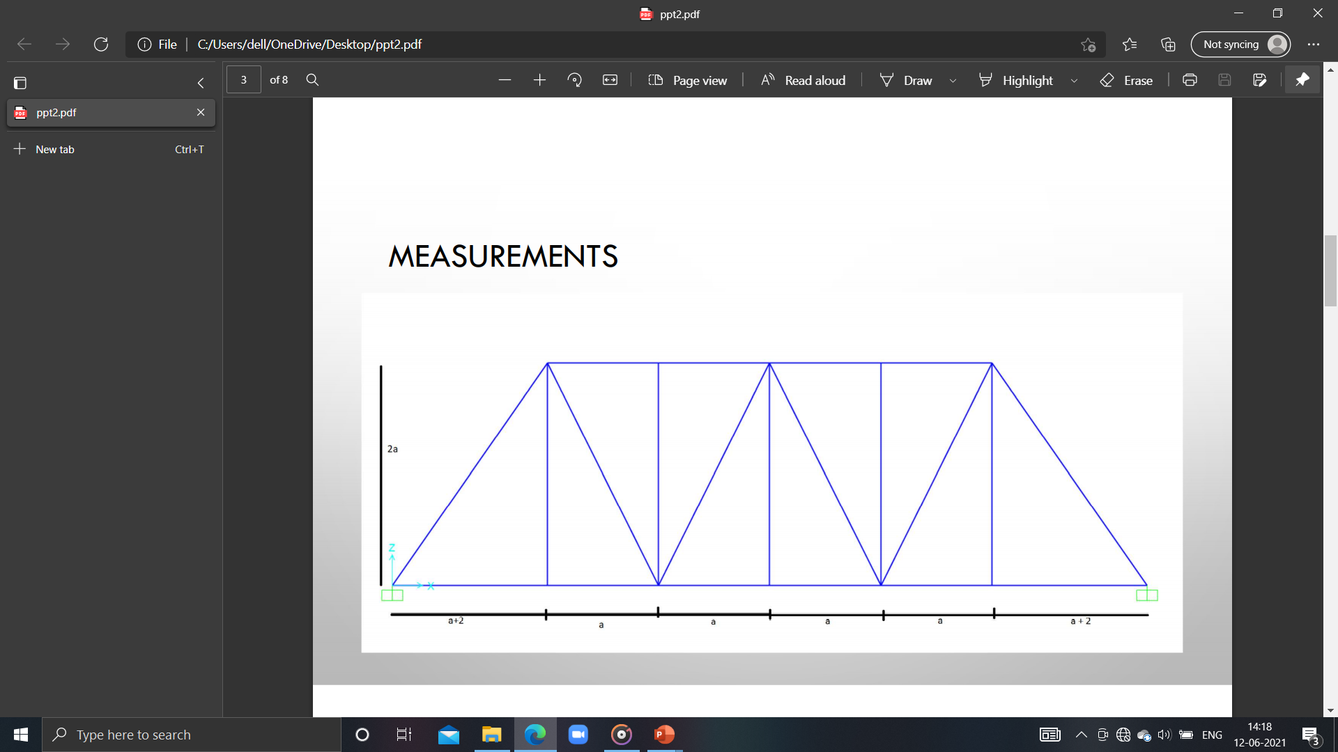
GIVEN MODEL :
UNIT SYSTEM : N , m , C
a= 3 (ROLL NO. =200728 since 3+0=3)

Slide 3
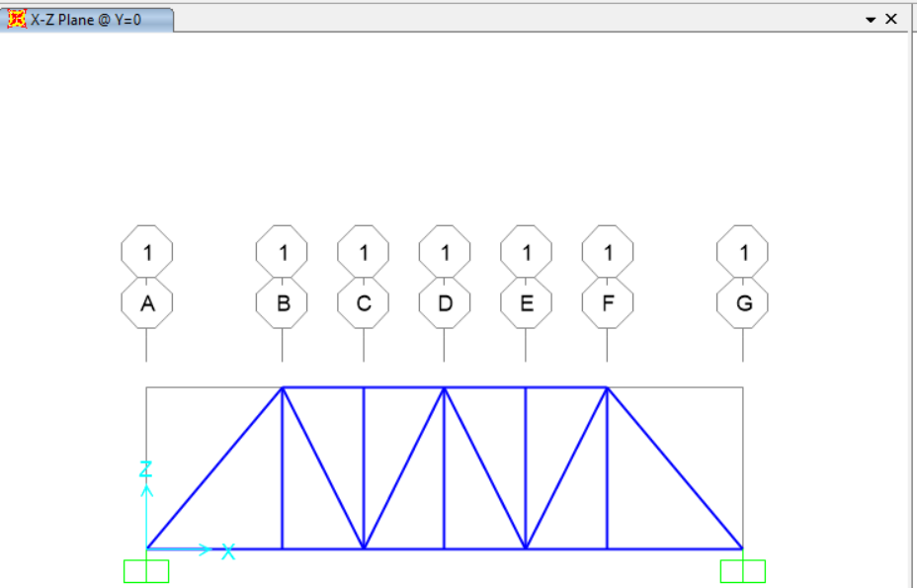
PICTURE OF UNDEFORMED STRUCTURE IN X-Z PLANE :

Slide 4
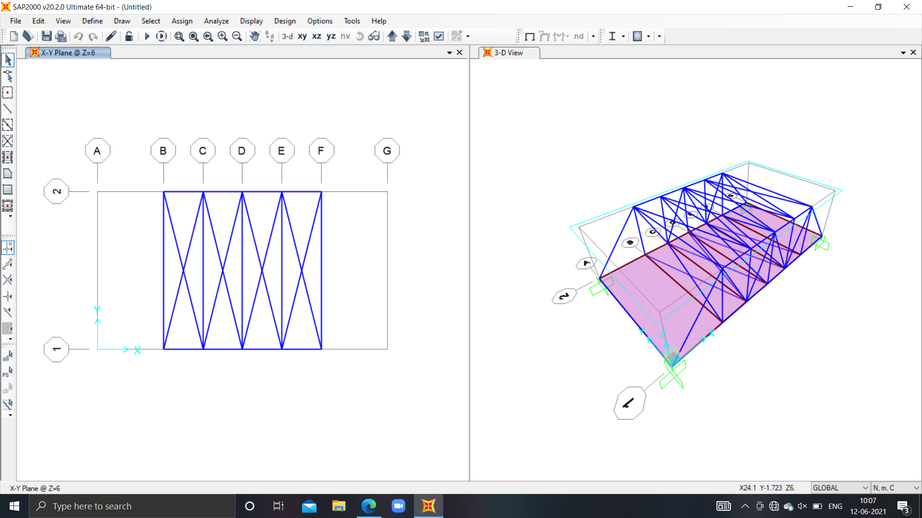
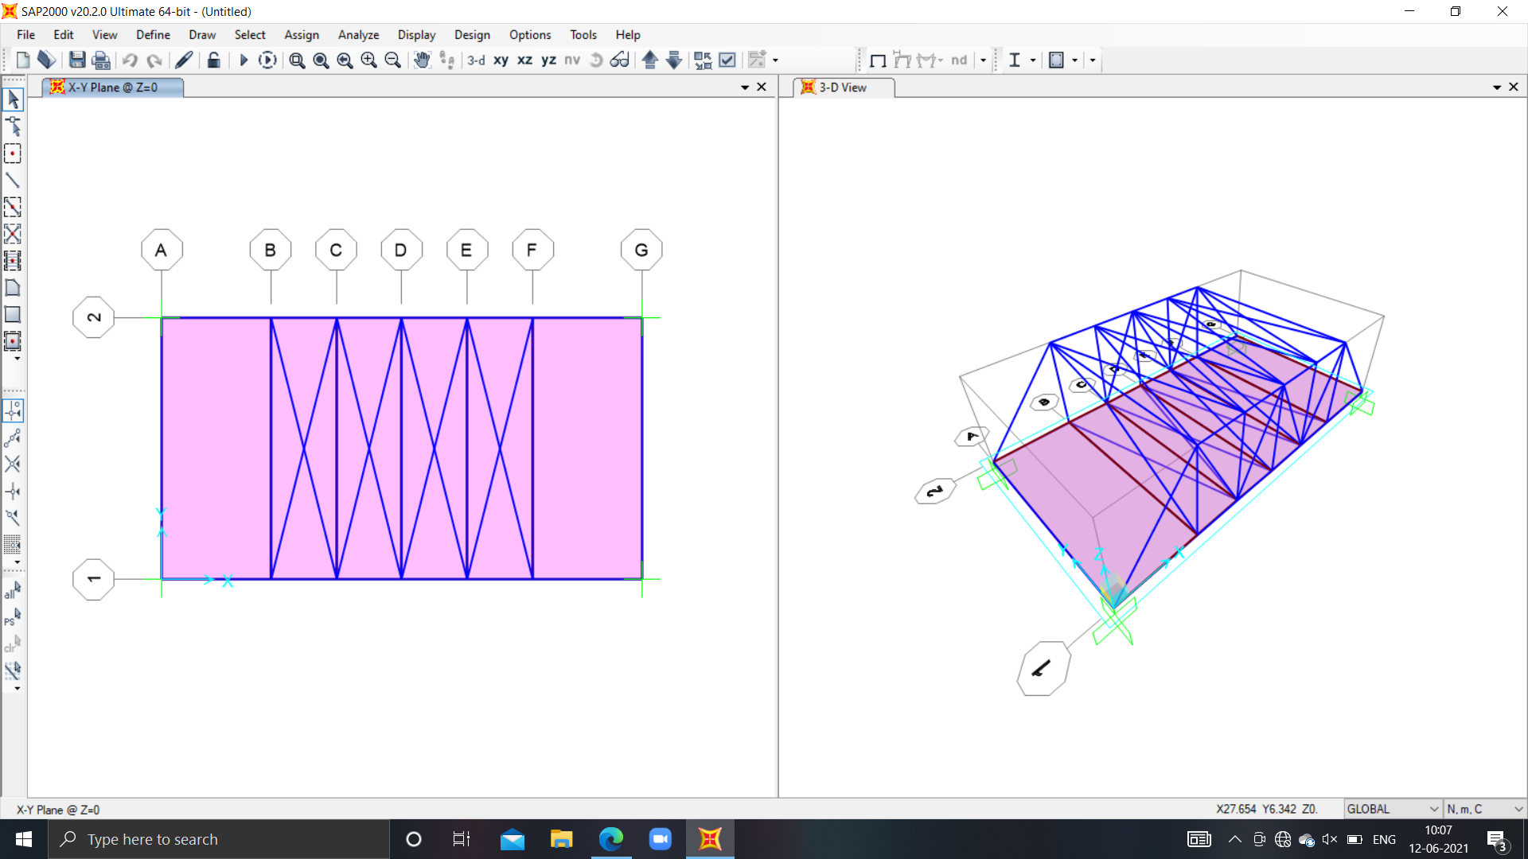
PICTURE OF UNDEFORMED STRUCTURE IN X-Y PLANE :
Z=6
Z=0

Slide 5
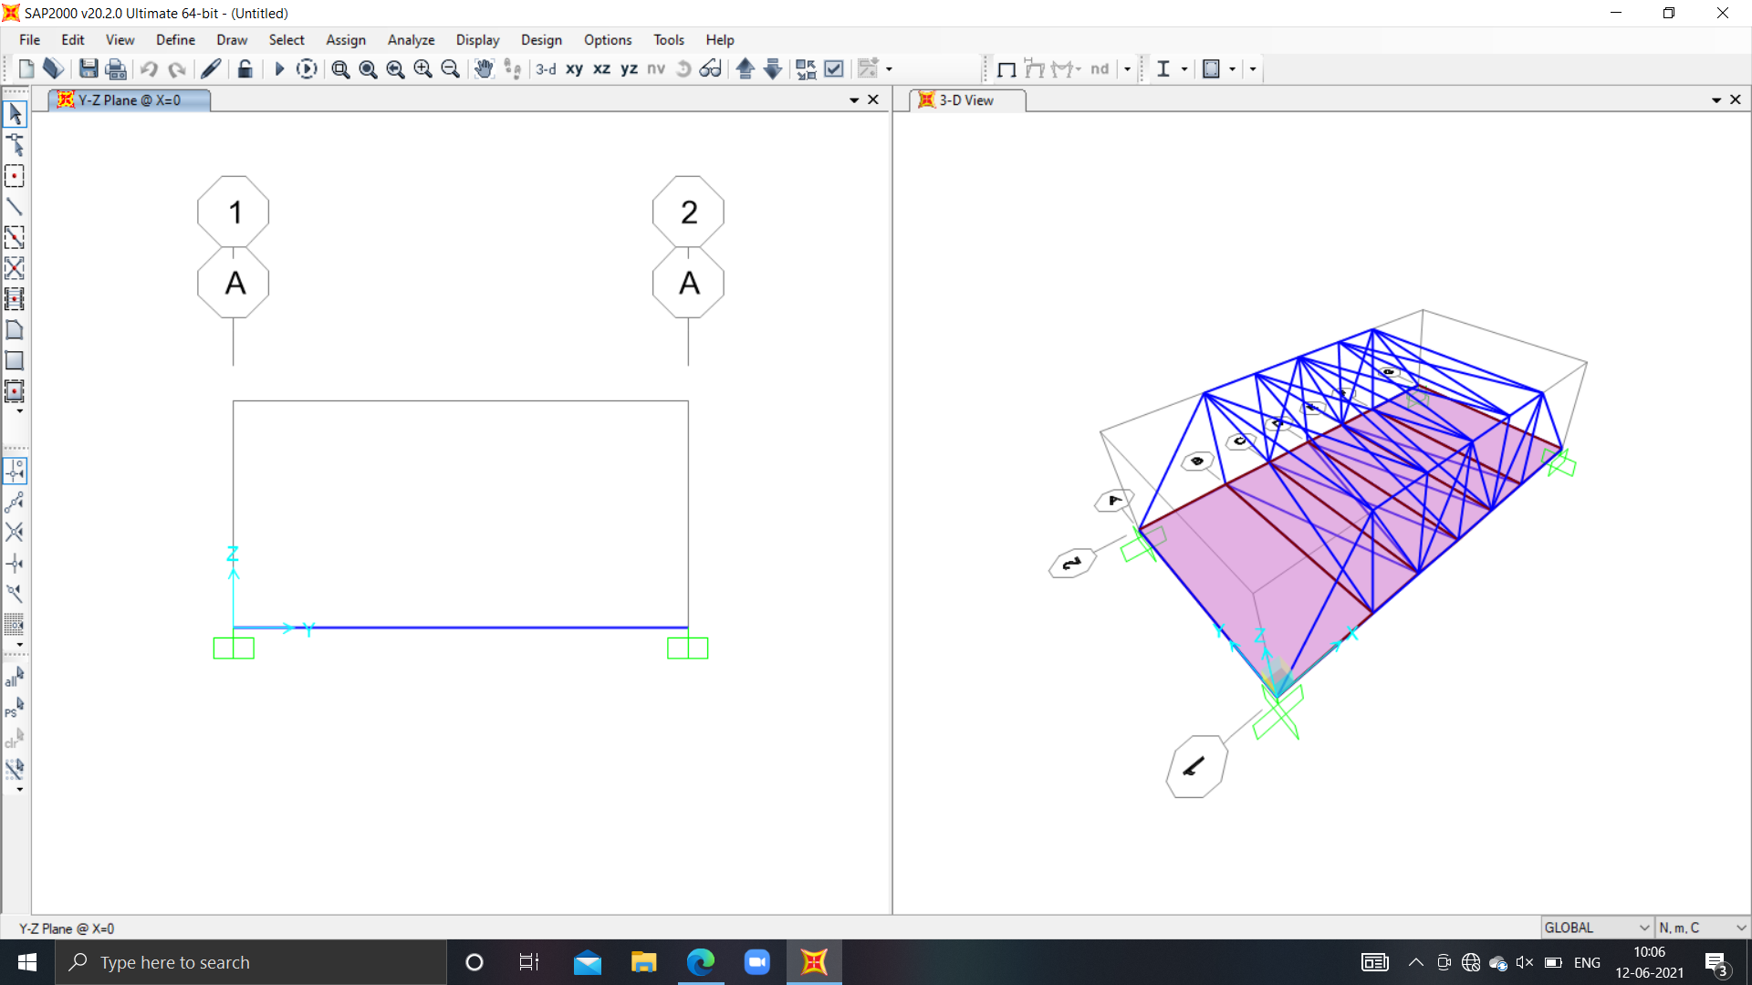
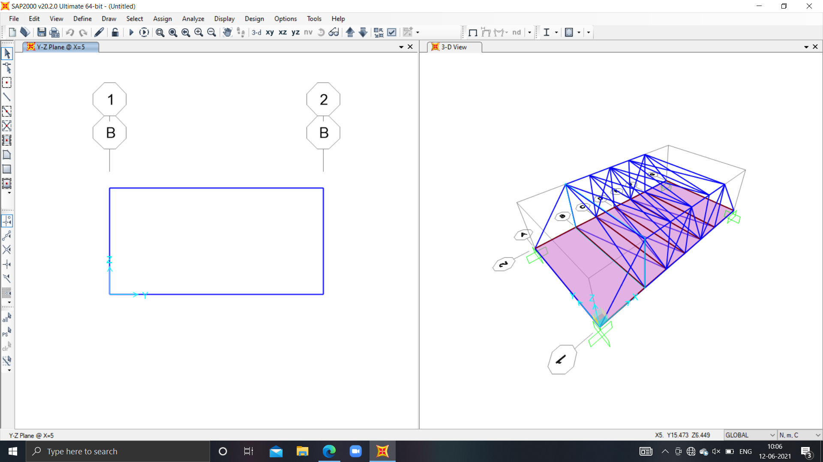
PICTURE OF UNDEFORMED STRUCTURE IN Y-Z PLANE :
X= 0
X= 5

Slide 6
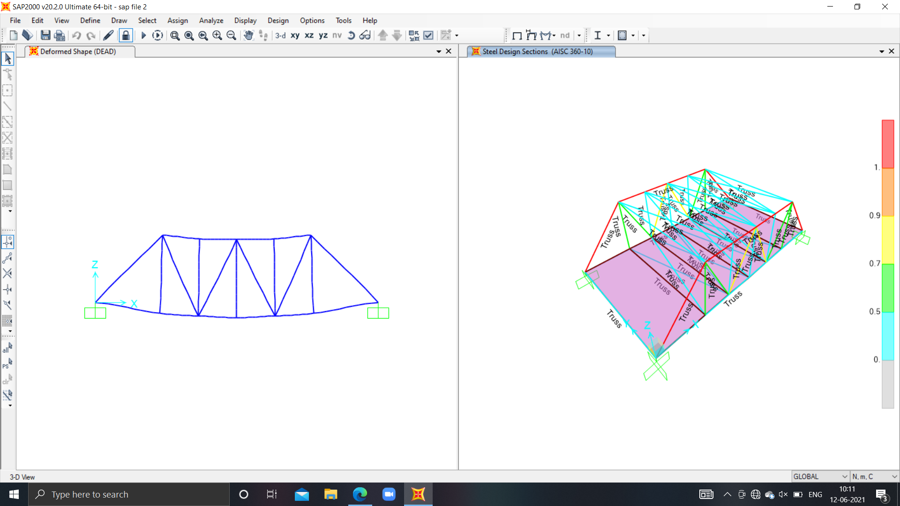
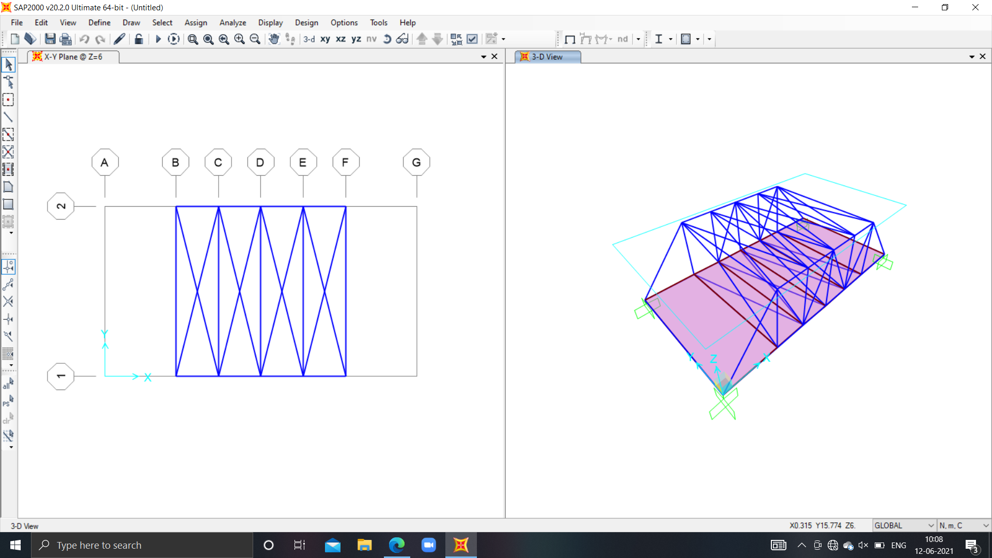
PICTURE OF UNDEFORMED STRUCTURE IN 3-D :

Slide 7
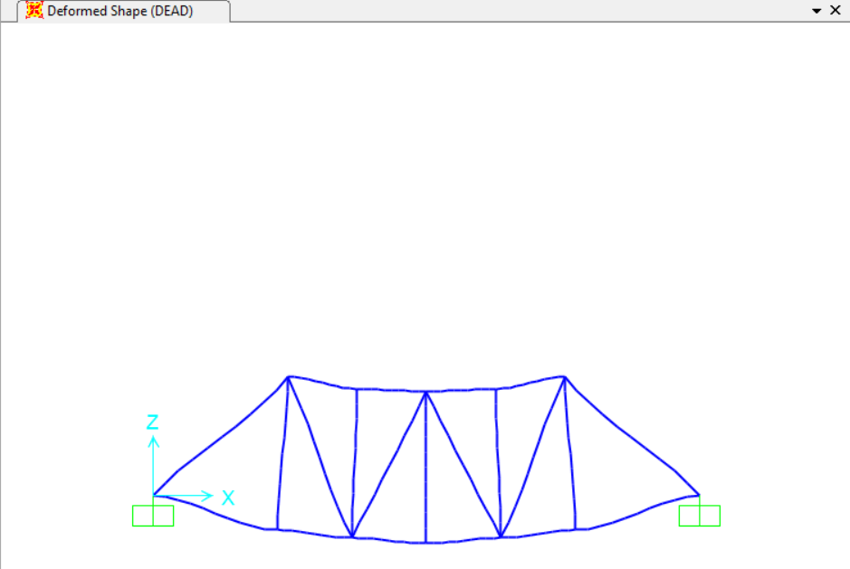
PICTURE OF DEFORMED STRUCTURE IN X-Z PLANE :

Slide 8

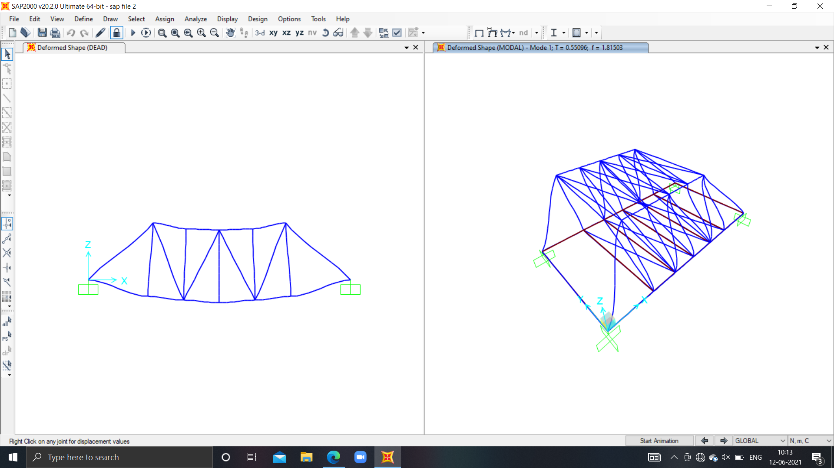
PICTURE OF DEFORMED STRUCTURE IN 3-D :

Slide 9
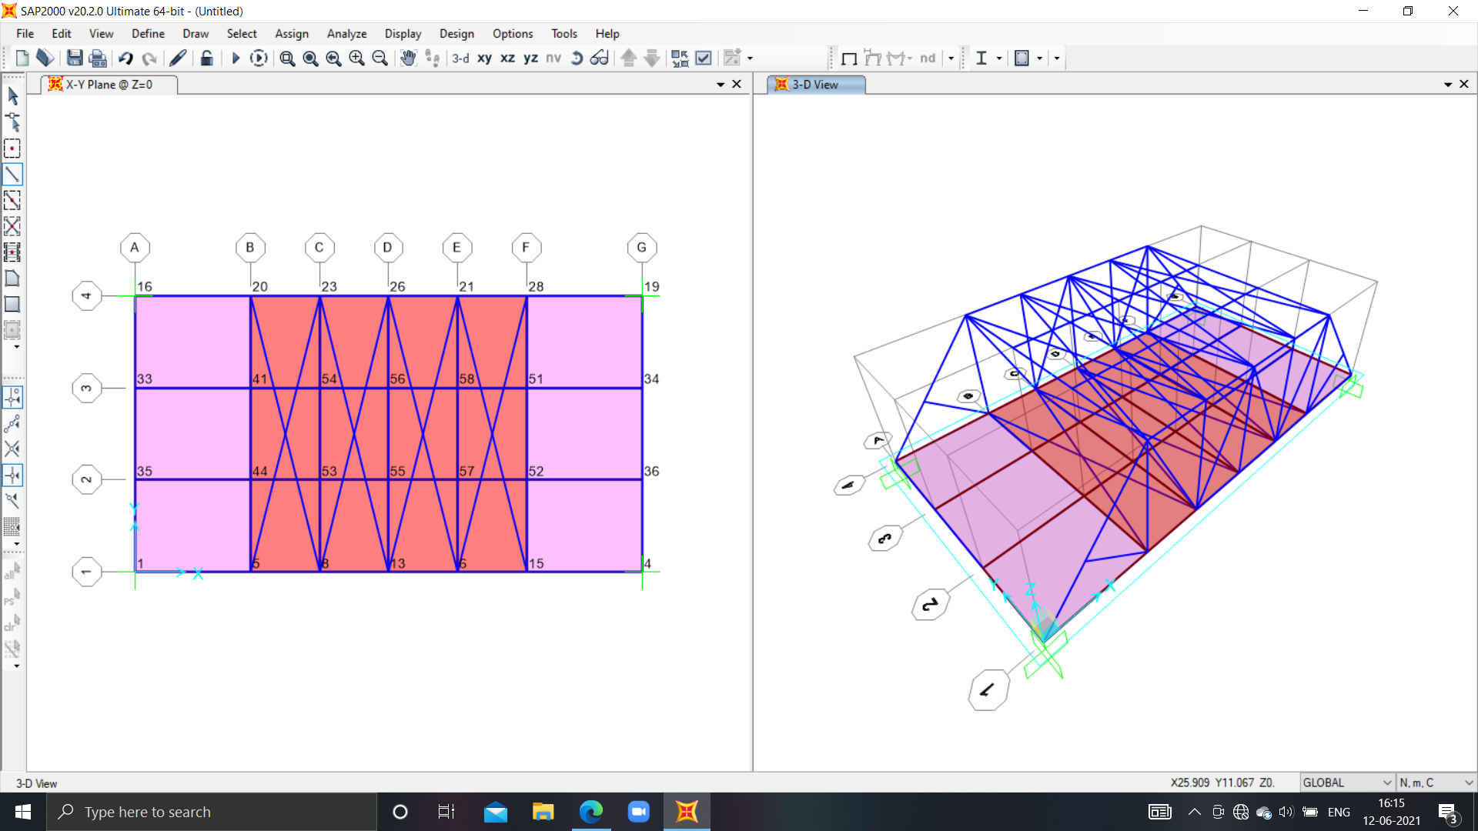
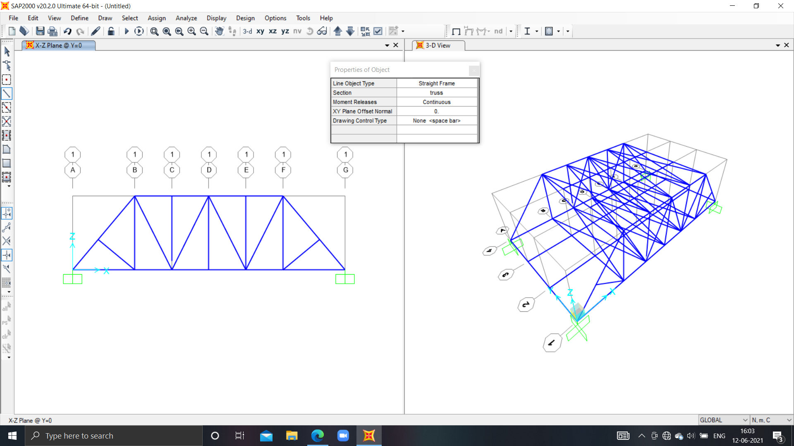
PICTURE OF NEW STRUCTURE WITH BETTER STRENGTH IN 3-D :
New 3-D model :
CHANGE 1 :
PERPENDICULAR MEMBER IS ADDED ON BOTH SIDES IN X-Z PLANE

Slide 10
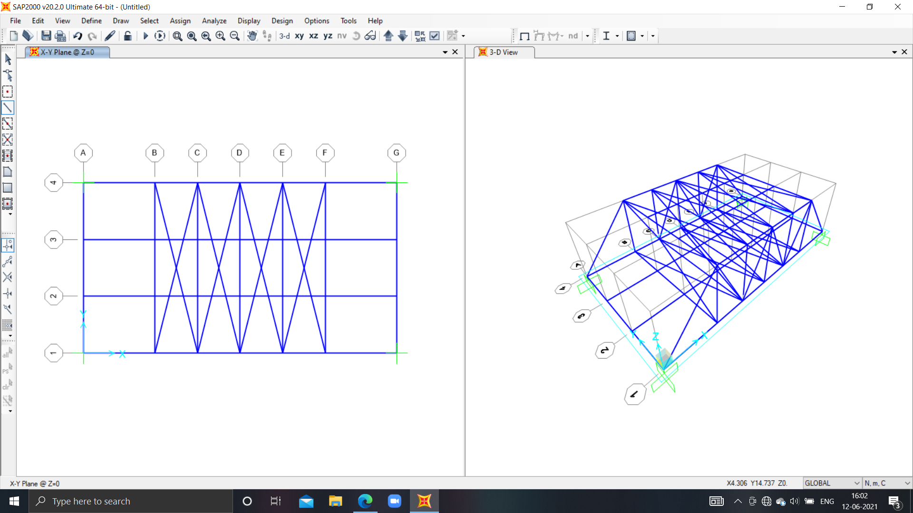
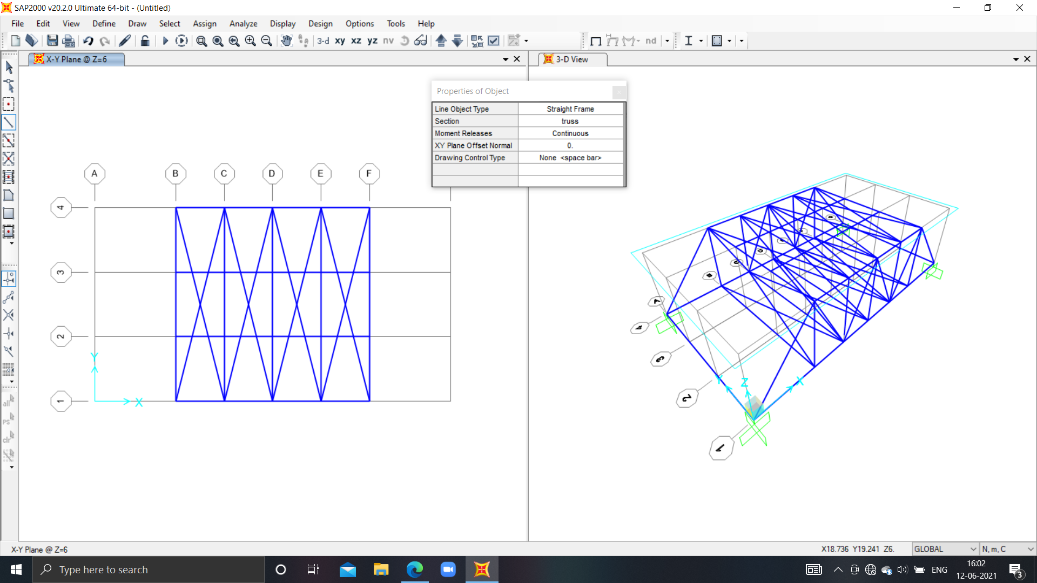
CHANGE 2 :
TWO MEMBERS ARE ADDED AT TOP THAT IS,
IN X-Y PLANE AND AT Z=6.
CHANGE 3 :
TWO MEMBERS ARE ADDED AT BOTTOM THAT IS,
IN X-Y PLANE AND AT Z=0.

Slide 11
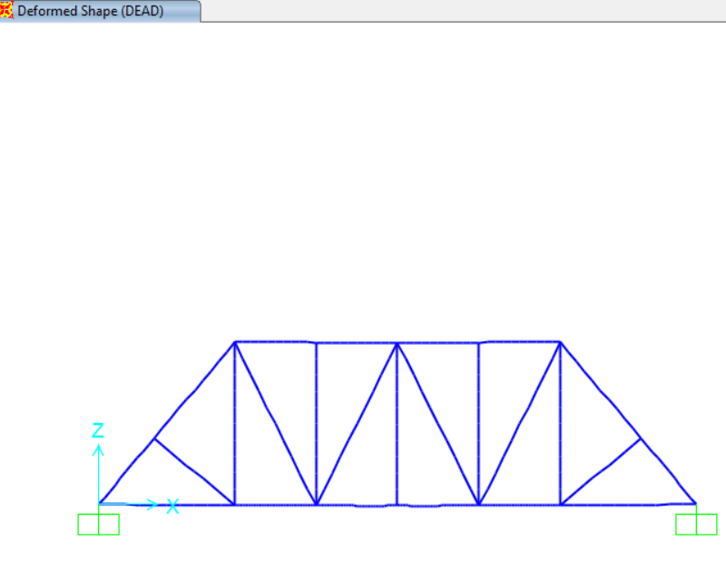
DEFORMATION CAUSED IN DIFFERENT CASES IN X-Z PLANE :
EARLIER CASE
AFTER REFORMATION
(NOTE THAT : DEFORMATION IS LESS IN THIS CASE)

Slide 12
THANK YOU
By: PRIYA SINGH
Roll no. :200728

